Slide 1
iGo eApplication
Presented by… Trevor Keeble
Director of Product Training
Policies issued by American General Life Insurance Company ("AGL“)
Notes:
iGo eApplication is a quick, efficient way to submit your applications. Using the eApp ensures your applications are submitted in good order (IGO) and can help speed up processing and issue times.

Slide 2
Ways to Access
Notes:
There are a couple of different ways that you can access iGo eApplication.

Slide 3
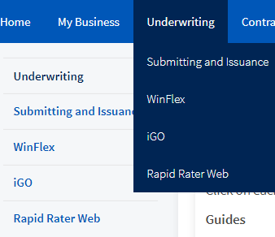
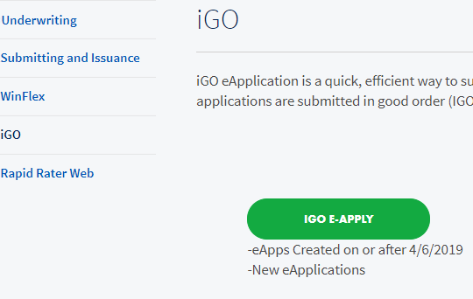
Option 1: Through Connext
On Connext
iGo
Notes:
The first way is through the agent portal, eStation.
After signing into eStation, click the Sales/Marketing link in the top bar then choose “iGo eApply”
This will launch the eApplication system for you to begin.

Slide 4
Option 2: Through Connext
On Connext
Click Home Tab
Click Get Started for e-apply
Notes:
You will also notice there is an iGo eApply button on the home page of eStation. It is towards the bottom of the page but allows the same access that was just shown by clicking the link at the top of the page.

Slide 5
Start a new case from scratch
View previous cases that have been started or submitted in iGo eApplciation
Notes:
Here is what the system looks like after clicking either of those 2 links. You have the option to start a new case or you can view cases that you have previously started to work on or submitted.

Slide 6
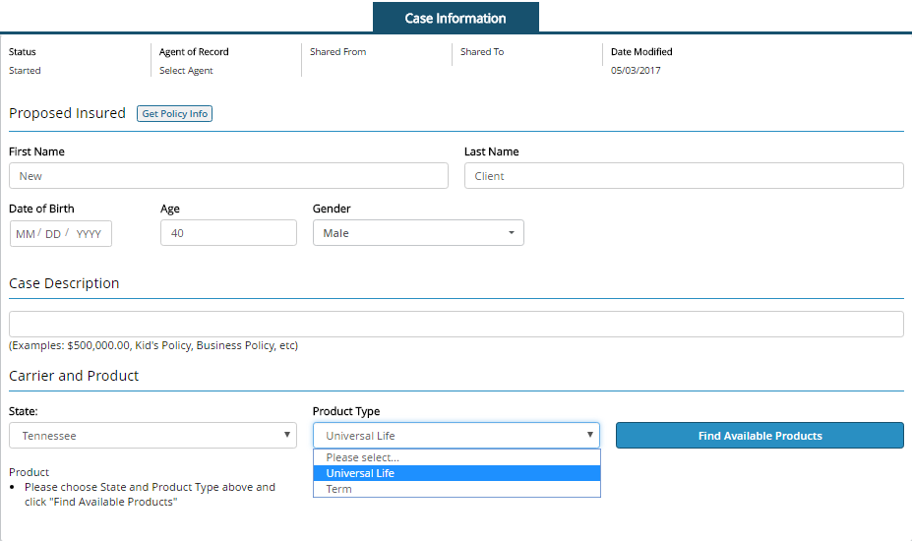
Start New Case
Enter Proposed Insured Info
To easily recall later
Notes:
If you click on Start New Case you will be prompted to enter some information to ensure the correct application will populate for you. You must enter the proposed insured’s name, date of birth, and gender.
You may enter a Case Description if you would like. Providing a description to your case will help you easily recall it from “View My Cases” if you need to make any changes or want to check the status of it later.
Finally, to ensure all the proper forms are populated you need to enter the state where the application is being written then select the product type. After completing, select “Find Available Products”.

Slide 7
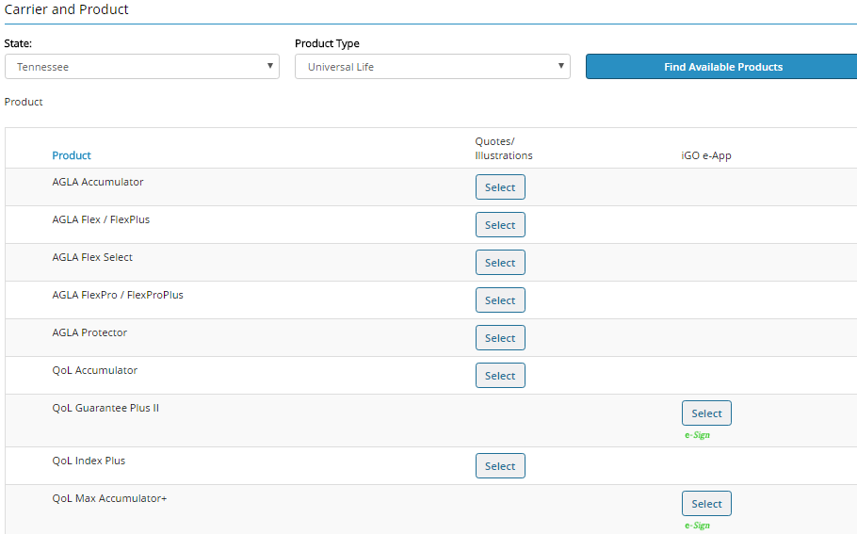
Find Available Products
Run a quotation/illustration or start the eApplication for the correct product by choosing “Select” for the appropriate action.
Notes:
You will then be given a list of products based off the information you just submitted. You have the availability to run a quotation or illustration for the products or start the eApplication by clicking the corresponding “Select” button.

Slide 8
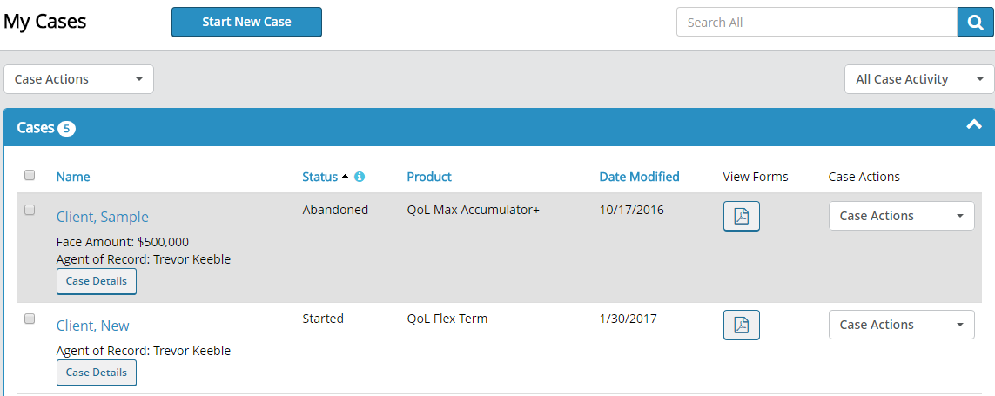
My Cases
Provides Case Details (Name, Face Amount, Agent of Record)
Status of the case
Product
Date Modified
Notes:
The “View My Cases” section looks like this. You can see the case details like the client name, face amount, and agent of record. You can also see the status of each case, the product name, and the date the application was last modified.
You can also filter your cases at the top by using the search bar, changing the Case Actions, or filtering by the Case Activity.

Slide 9
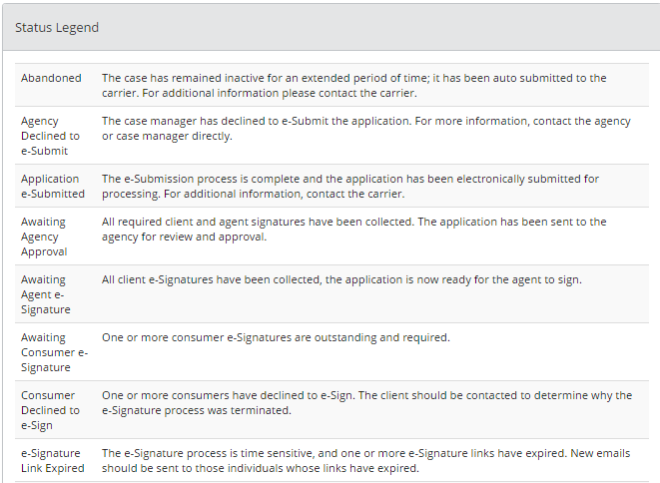
Status Legend
Provides details about what each of the statuses means as well as any action that needs to be taken.
Notes:
If you click the “i” button next to Status it will provide the Status Legend so you can see all of the details about what each of the statuses means as well as any action that needs to be taken for a particular status.

Slide 10
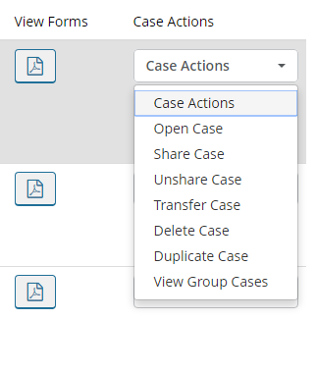
My Cases
View all required forms in PDF format to save or print
Choose which action you would like to complete for the case
Notes:
Finally, for each of the cases you may view all required forms in PDF format to save or print. You may also choose which case action you would like to complete for the particular case.

Slide 11
Option 2: Through WinFlex Web
Design the illustration the way you would like to issue the policy.
Calculate the illustration then select “eApply”
This method transfers all of the data from the illustration directly into the eApplication instead of having to enter all of the insured’s data like in Option 1.
Notes:
The other way you can access the eApplication is through WinFlex Web. With this method, you first are running an illustration and designing it the way you would like to issue the policy.
After calculating the illustration, simply click the green “eApply” button in the Illustration Results Page.
This method transfers all of the data from the illustration directly into the eApplication instead of having to enter all of the insured’s data like in option 1.

Slide 12
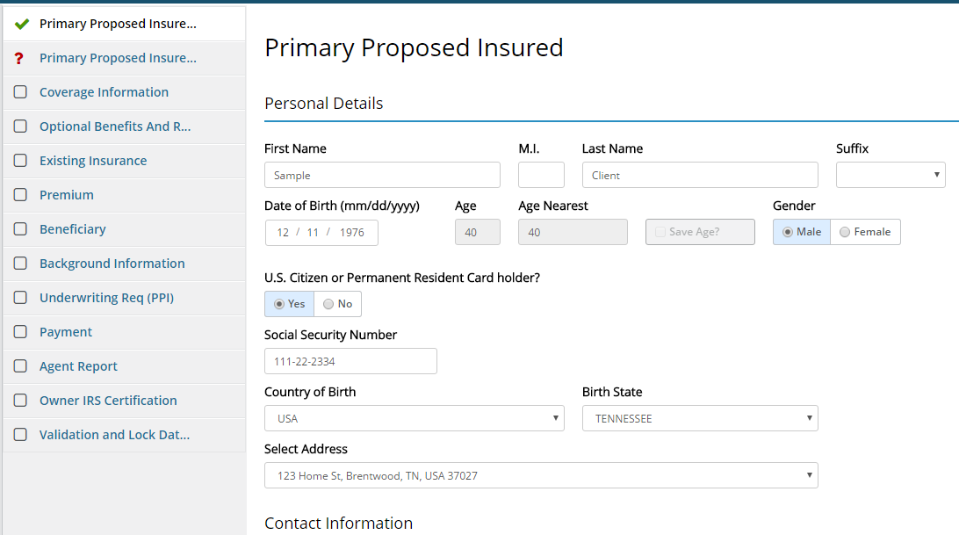
iGo eApplication Helpful Hints
Easily identify which sections are complete or incomplete
Notes:
Using the iGo eApplication makes it easy to see which parts of the applications has been completed. The bar on the left hand side of the page will show a green check mark for those sections that are done and will show a red question mark for those sections that need additional information.
Remember, you will not be able to submit the eApplication until each section has a green checkmark to ensure all sections of the application have been completed.

Slide 13
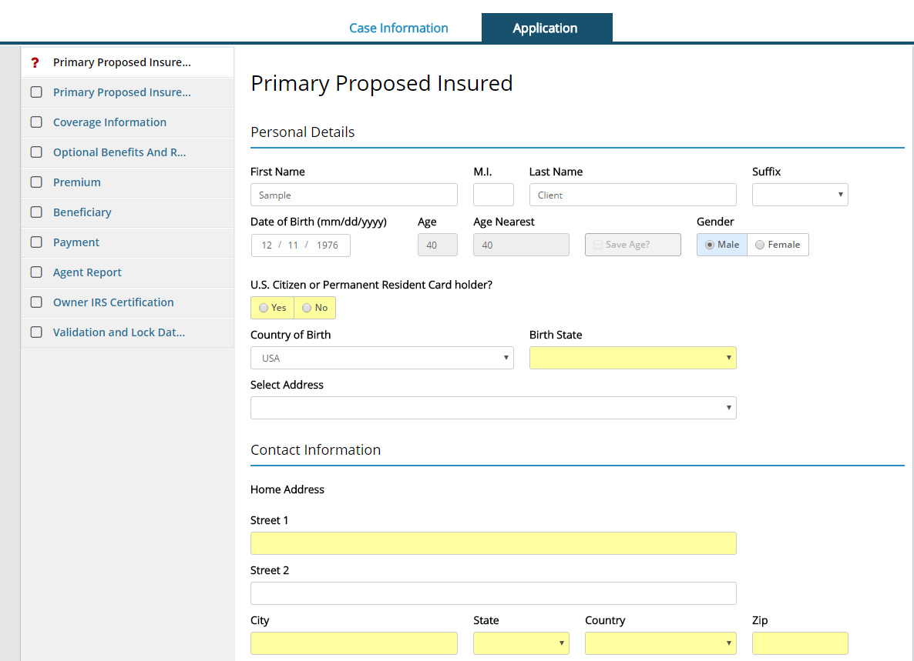
Primary Proposed Insured
Yellow fields are required
Notes:
We will walk through a sample case so you can see how the eApplication system looks and works. Please remember that this is just a basic case. Your case may require additional details depending on how the case is being designed and issued for your client.
The first section is for the Primary Proposed Insured. This section is asking for basic information like the name, date of birth and gender. It also asks if the insured is a US citizen or permanent resident card holder, their country and/or state of birth, as well as their contact information.
Remember, if you accessed eApp through WinFlex Web, the insured’s information that you included in the illustration will automatically be transferred for you so you don’t have to duplicate your work.
The eApp makes it easy to identify which pieces of information are required for the application. Each field that is highlighted in yellow means that you must complete that information before the section will be marked as complete.

Slide 14
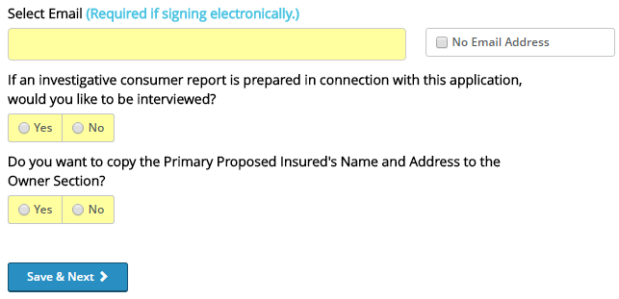
Primary Proposed Insured
Required for electronic signature
Notes:
Also in the Primary Proposed Insured section, you must provide an email address for the insured if you are doing an electronic signature. The electronic signature method is the most common when doing the eApp so we will discuss that process in a little bit.
After you have completed all of the required information in a section, simply click the “Save & Next” button at the bottom of the page to move to the next section.

Slide 15
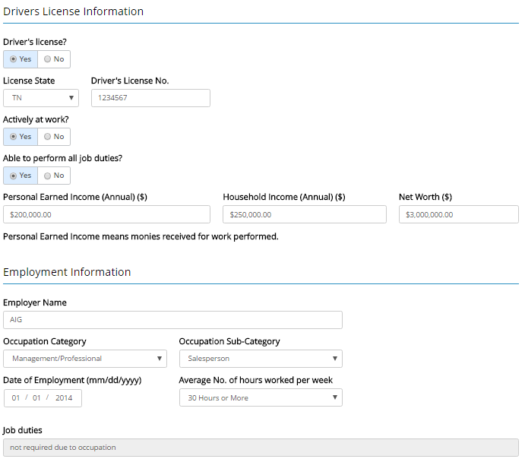
Primary Proposed Insured, Cont.
Notes:
There are 2 sections in the eApplication for the Primary Proposed Insured. The second section needs the insureds’ drivers license information, work and income details, as well as their employment information.

Slide 16
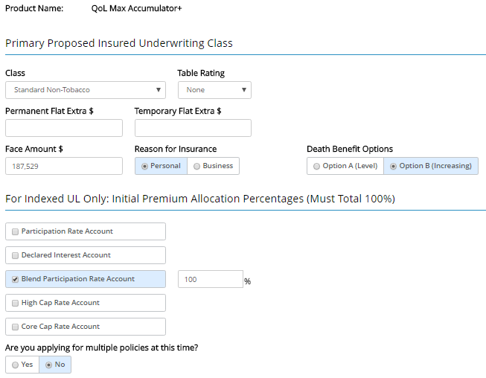
Coverage Information - Base
Information transferred directly from illustration since eApplication was launched via WinFlex Web
Notes:
Next comes the Coverage Information Section for the base insured. Again, this information will mirror the illustration if accessed through WinFlex Web.
The product, UW class, face amount, reason for insurance, DB options, and index strategy allocations (for indexed UL policies only) is covered in this section.
Additionally, if you are using our QoL Advantage program where multiple policies are being applied for at the same time, you need to indicate that in this section.

Slide 17
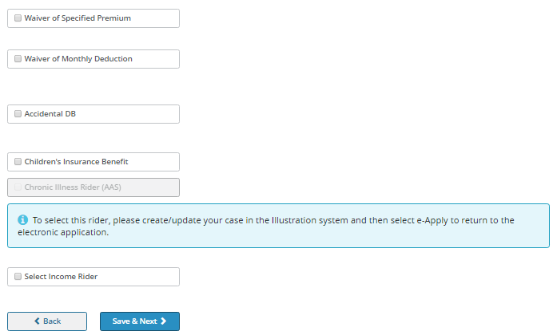
Optional Benefits And Riders - Base
Select any additional riders you would like to include on the policy.
For cost rider, which is why the illustration would need to be adjusted
Notes:
The Optional Benefits and Riders section will ask about any additional riders that are to be included on the application.
You can see that for some riders there is a charge for a note appears indicating that your case in the illustration system needs to be updated to include the rider so the information can be transferred.

Slide 18
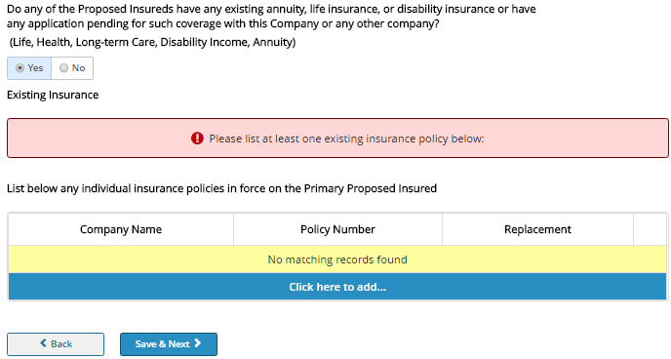
Existing Insurance
If answer is “Yes”, you must click to add the additional coverage information.
Notes:
The next section is all about the insured’s existing insurance.
If the answer to the question is “Yes” you are required to list the existing insurance policy(ies).
Click the “Click here to add…” button to add the information for their existing policies.

Slide 19
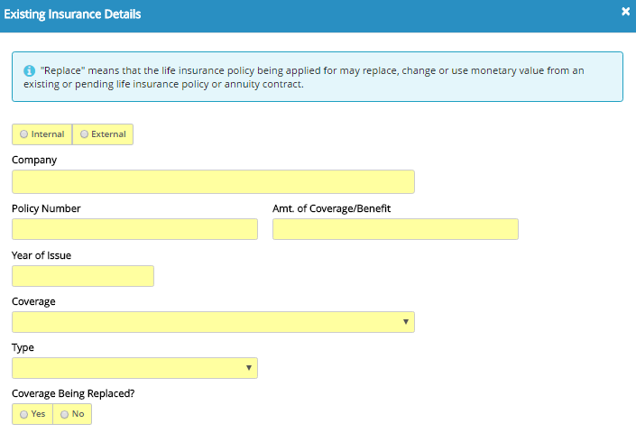
Existing Insurance Details
You must complete all of the required information for the existing coverage(s) the insured has.
Notes:
Here is what it looks like once you have clicked to add the existing policy information.
It is important that all of the information is completed for EACH of their existing policies. If they have more than one existing policy, you will need to choose the “Click here to add…” button to include each additional policy.

Slide 20
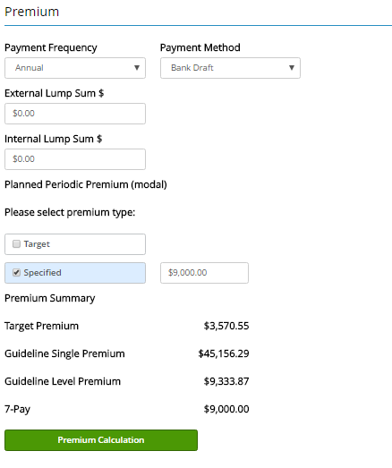
Premium
Information is pulled directly from the illustration.
If “Premium Calculation” button is NOT green, you must click on it to validate the premium amount.
Notes:
Next is the Premium section. Please include the payment frequency, payment method, and any external or internal lump sum information.
You then will select either “Target” or “Specified” for the premium type. The Specified option allows you to input a specific premium amount or it will have automatically transferred the premium figure from the illustration if accessed from WinFlex Web.
If the Premium Calculation button is not green, you must click it to validate the premium amount. Once validated, the button will turn green and you will be able to continue to the next section.

Slide 21
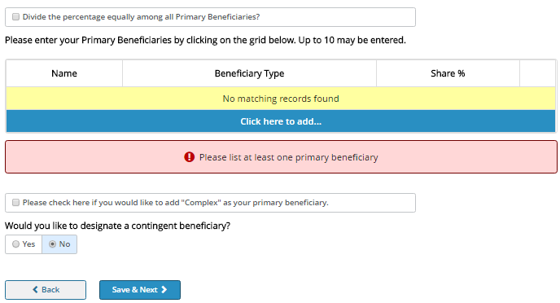
Beneficiary
Notes:
You then will need to enter the beneficiary information for the application. You will need to include the primary beneficiary information by choosing “Click here to add…”
You may also include a contingent beneficiary if there are any for the case.

Slide 22
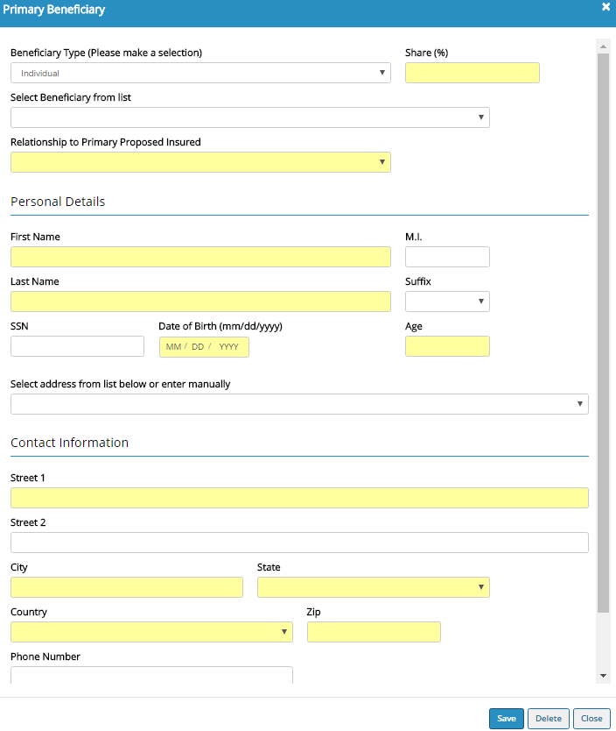
Primary Beneficiary
If more than one beneficiary, put the “Share (%)” for the first one then follow the same steps to add another beneficiary.
Notes:
Here is what you will see when completing the primary beneficiary section. Please complete all of the required fields.
If you are adding more than one primary beneficiary put the Share (%) for the first one then follow the same steps to add another beneficiary.

Slide 23
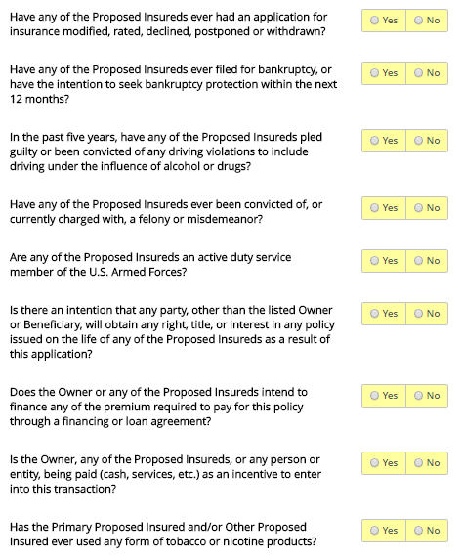
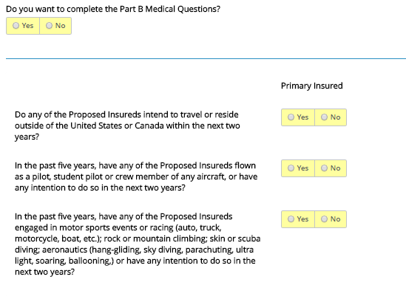
Background Information
You must answer each of the background questions.
Notes:
After that, you will need to complete all of the background information questions.
Be sure to read each question thoroughly before selecting an answer.

Slide 24
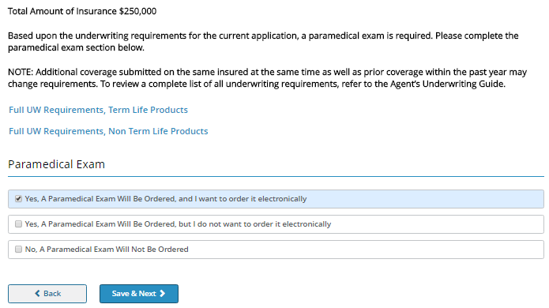
Underwriting Requirements
If age and face amount requirements on the application require a paramed exam, you must indicate how it will be ordered.
Notes:
The Underwriting Requirements section will tell you whether or not a Paramedical Exam is required. If the age and face amount requirements on the application require a paramed exam, you must indicate how it will be ordered.

Slide 25
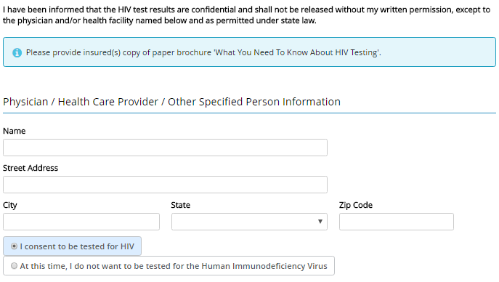
HIV
Be sure to leave behind the required brochure.
Notes:
Please also complete the HIV section and indicate whether or not the insured consents to be tested for HIV.
Also note that you need to provide the insured(s) copy of the paper brochure “What You Need To Know About HIV Testing”.

Slide 26
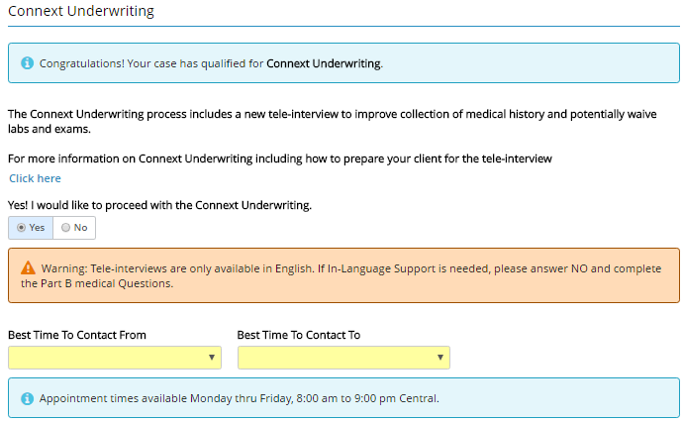
Background Information – Non Medical UW
Certain products offer non-medical UW for specific ages and face amounts.
If your case qualifies, this is what you will see in the Background Information screen.
If so, the paramed exam screen will not populate in the eApplication.
Notes:
There are certain products that offer non-medical underwriting for specific ages and face amounts.
If your case qualifies, these are the details you will see in the Background Information section. And, if your case qualifies for the non-medical underwriting the paramed exam screen will not populate since it is not applicable to non-medical UW cases.
For non-medical UW cases, the Application Part B needs to be completed. By keeping “Yes” selected to the question, “Yes! I would like to proceed with Connext Underwriting.” indicates you would like our vendor to complete the Application Part B for you. You then need to indicate the best time for the vendor to reach the insured.
If you select “No”, the Application Part B questions will be populated in the eApplication and you must complete them yourself before the application can be submitted.

Slide 27
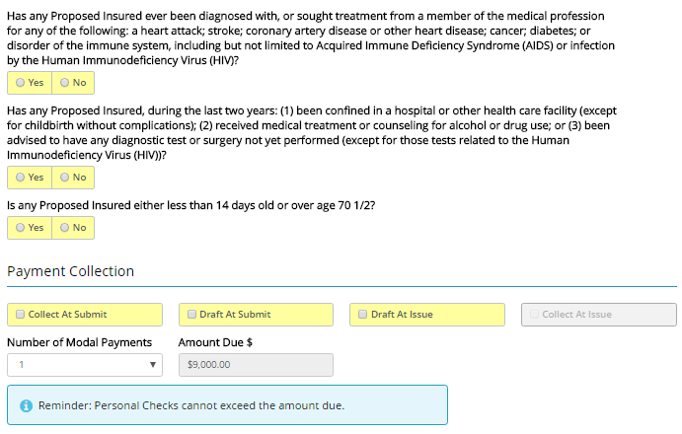
Payment Information
If you select Draft At Submit or Draft At Issue no premiums can be collected.
Notes:
The next section is for the Payment Information.
Please answer the questions on this screen and indicate how the payment will be collected.
Remember: If you select Draft at Submit or Draft at Issue no premium can be collected. If you Collect At Submit, personal checks cannot exceed the amount due.

Slide 28
Automatic Bank Check (ABC) Authorization
This screen will populate if you elect to have the premium drafted.
Notes:
If you elect to have the premium drafted, the Automatic Bank Check (ABC) Authorization screen will appear. We need the information for the bank account owner, the bank account information, and the withdrawal day.
Remember: Please always enter a valid bank account number to ensure the premium is drafted correctly. Additionally, no insurance becomes effective until the Company receives the initial premium.

Slide 29
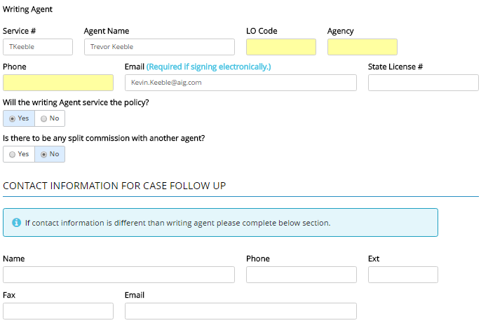
Agent Report
Complete writing agent and contact information for case follow-up (if different from writing agent)
Notes:
Please fill out your information in the Agent Report Section. Also, make sure to provide contact information for case follow-up if it is different from the writing agent information.

Slide 30
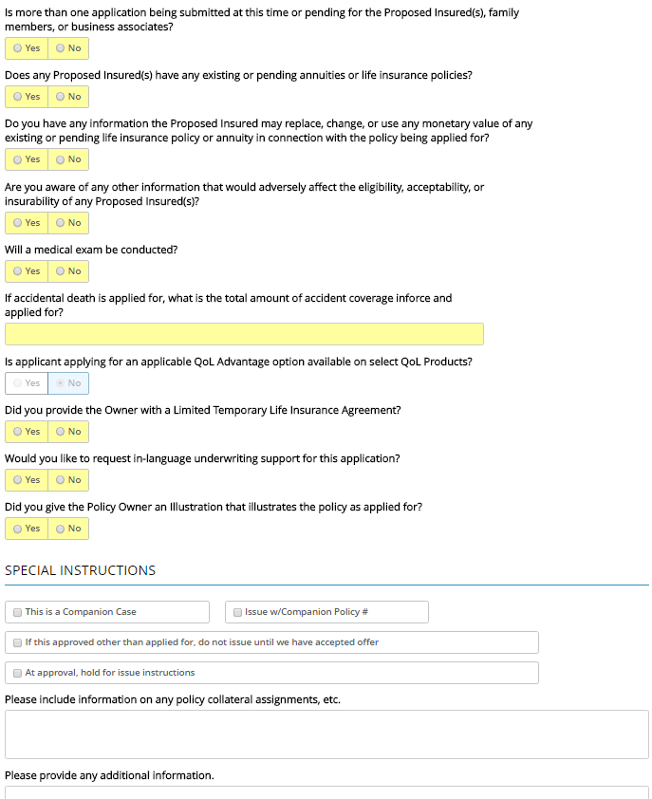
Agent Report
Provide any special instructions and additional policy information at the bottom of the Agent Report.
Notes:
After answering all the questions on the agent report be sure to provide any special instructions and additional policy information at the bottom of the page.

Slide 31
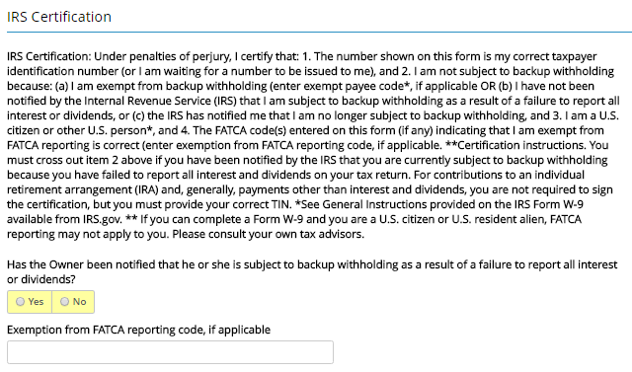
Owner IRS Certification
Notes:
Answer the question on the Owner IRS Certification screen.
NOTE: This screen is asking specifically about the policy OWNER. Make sure to answer accordingly if the owner is different from the insured.

Slide 32
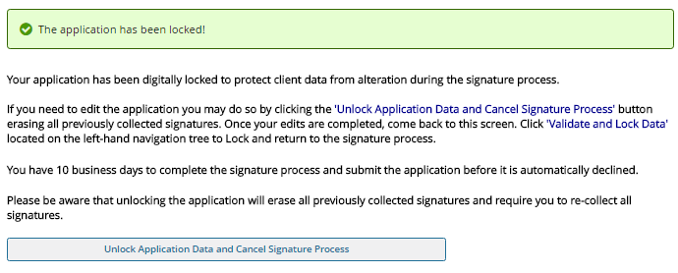
Validation and Lock Data
You must lock the application to proceed to the signature process.
Once locked the following screen will appear.
Notes:
After you have completed all of the sections we just walked through, and green checkmarks appear next to each of them, the Validation and Lock Data screen will tell you “Congratulations! Your application is ready for signatures!”
The application must be locked to proceed to the signature process. Do this by clicking on the “Lock Application and Proceed to Signature Process” link.
Once it is locked the following screen will appear letting you know.
If you need to go back and make edits or changes to any section of the application you must first Unlock the application. After the changes are made you may be required to revisit some of the application pages to ensure everything else remains accurate. And the application must be locked again before you can proceed to the signature process.

Slide 33
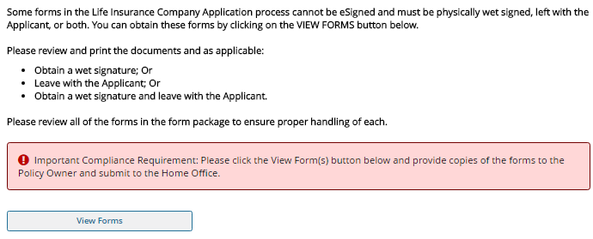
Forms To Be Wet Signed or Left With the Applicant
Click “View Forms” to see if your application has any of these forms that apply.
Notes:
Depending on the state and/or the product there may be some forms that cannot be eSigned and must be physically wet signed, left with the applicant, or both.
You cannot proceed past this point until you click the “View Forms” button.
Please review and print the documents and as applicable:
-Obtain a wet signature; or
-Leave with the applicant; or
-Obtain a wet signature and leave with the applicant
Please click the “View Forms” button and provide copies of the forms to the Policy Owner and submit to the Home Office.

Slide 34
Choosing a Signature Method
Application may be signed via eMail or via face-to-face.
Notes:
Next you need to choose a signature method.
Unchecking the “Collect all Client’s Signatures Electronically” will require you to print out the application, obtain wet signatures in all locations, then submit the paper copy to the Home Office.
The more effective method is to collect all of the signatures electronically.
The application may be eSigned via eMail or eSigned via Face-to-Face.

Slide 35
eSign via Face-to Face
Notes:
Lets take a look at the eSign via Face-to-Face method first.

Slide 36
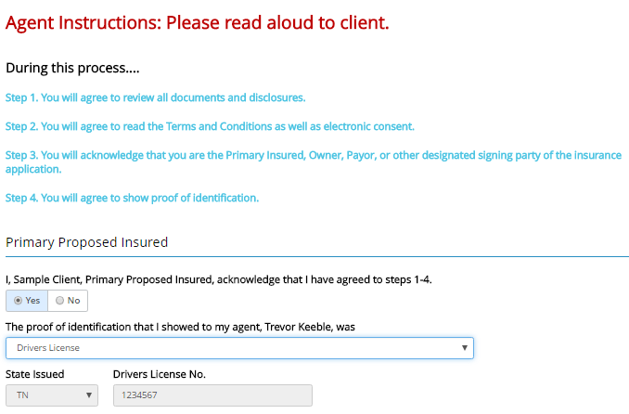
eSignature Disclosures
Notes:
When choosing to sign via this method the eSignature Disclosures are the first thing you will see.
IMPORTANT: Please read aloud to the client:
During this process…
Step 1. You will agree to review all documents and disclosures.
Step 2. You will agree to read the Terms and Conditions as well as electronic consent.
Step 3. You will acknowledge that you are the Primary Insured, Owner, Payor, or other designated signing party of the insurance application.
Step 4. You will agree to show proof of identification.
Then, the Primary Proposed Insured must acknowledge that they have agreed to steps 1-4.
NOTE: If the Owner, Payor, or other designated party is different from the insured they also must acknowledge and provide proof of identification.
Choose the prood of identification that you were shown and enter the information corresponding with that proof.

Slide 37
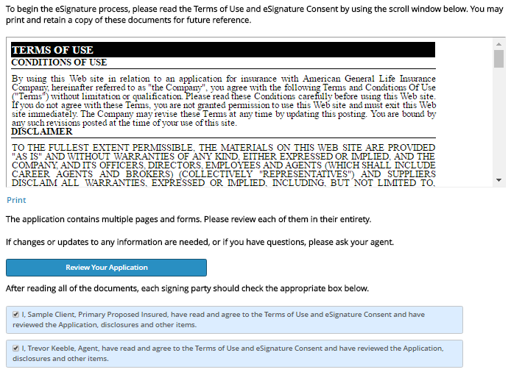
Terms of Use and eSignature Consent
Notes:
The insured must then follow the steps on the Terms of Use and eSignature Consent screen.
First, they must read the Terms of Use.
They then will be notified:
The application contains multiple pages and forms. Please review each of them in their entirety.
If changes or updates to any information are needed, or if you have questions, please ask your agent.
Click the “Review Your Application” button to comply with this process.
After reading all of the documents, each signing party should check the appropriate boxes shown at the bottom of the page.

Slide 38
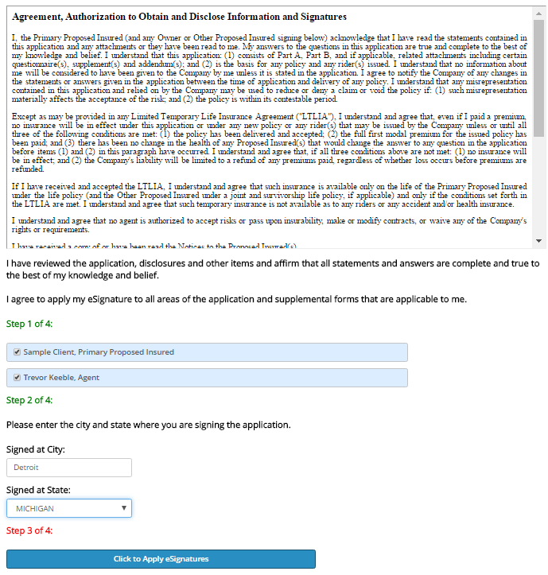
eSignature – Primary Insured, Owner, Payor, and other
Signing Parties
Notes:
Next comes the eSignature for the Primary Insured, Owner, Payor, and other Signing Parties.
There are 4 steps in this section that must be completed by the producer and each of the signing parties.
After completing steps 1 and 2, select “Click to Apply eSignatures” in the 3rd step. Doing so will provide the message:
“Thank you again for using our Electronic Application!”
The final step acknowledges that the eApplication process is complete.

Slide 39
eSign via eMail
Notes:
Now lets look at the eSign via eMail option.

Slide 40
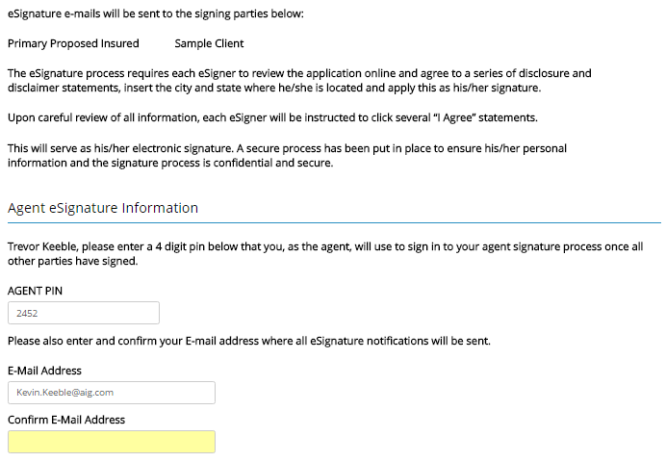
eSignature Instructions
Notes:
In this method, rather than completing the eSignatures face-to-face, an email will be sent to the signing parties providing them instructions on how to complete the eSignature process.
The eSignature Instructions screen will notify you who will be sent the eSignature emails.
As the agent, you will need to enter a 4 digit pin that will be used to sign in to your agent signature process once all other parties have signed.
Please also confirm the agent email address where all eSignature notifications will be sent.

Slide 41
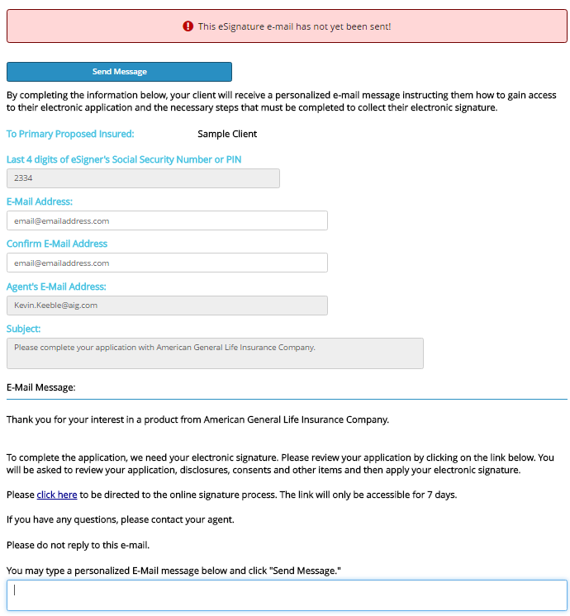
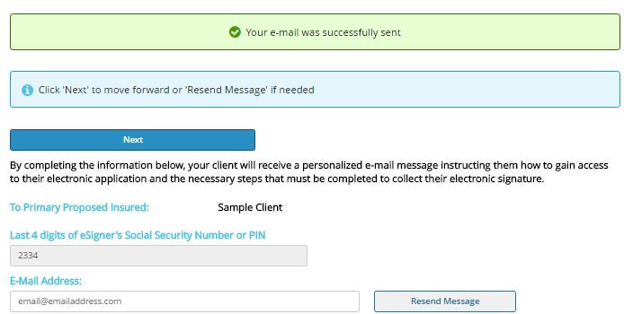
Primary Proposed Insured’s eSignature
Notes:
You will be able to tell whether or not the eSignature email has been sent. The box will appear red and notify you that it has not yet been sent. Once you select the “Send Message” box you will receive notification that the email was successfully sent.
If you need to resend the message to the signing parties you may do so here or click Next to continue.

Slide 42
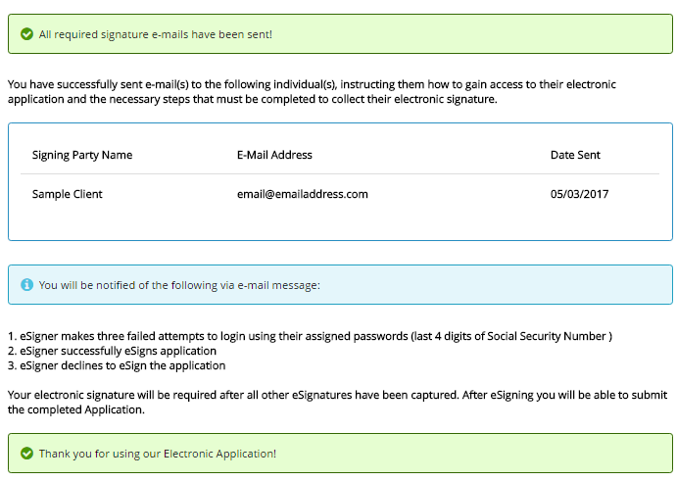
eSignature eMail Confirmation
Notes:
In the eSignature eMail Confirmation screen please note that you will be notified of the following via email message:
eSigner makes three failed attempts to login using their assigned passwords (last 4 digits of Social Security Number)
eSigner successfully eSigns application
eSigner declines to eSign the application
Your electronic signature will be required after all other eSignatures have been captured. After eSigning you will be able to submit the completed application.

Slide 43
Questions
Notes:
Read Slide

Slide 44
Important Information
Policies issued by: American General Life Insurance Company (AGL), Policy Form Numbers ICC15-15603, ICC15-15604, ICC15-15602, ICC15-15600, 82012, 82410, 88390, ICC14-14002, 14306, ICC15-15997, ICC15-15996, ICC15-15994, ICC15-15271, ICC15-15274, ICC15-15272, ICC15-15273. Issuing company AGL is responsible for financial obligations of insurance products and is a member of American International Group, Inc. (AIG). AGL does not solicit business in the state of New York. Products may not be available in all states and product features may vary by state. Guarantees are backed by the claims-paying ability of the issuing insurance company.
AIG is the marketing name for the worldwide property-casualty, life and retirement, and general insurance operations of American International Group, Inc. For additional information, please visit our website at www.aig.com. All products and services are written or provided by subsidiaries or affiliates of American International Group, Inc. Products or services may not be available in all countries, and coverage is subject to actual policy language.
This information is general in nature, may be subject to change, and does not constitute legal, tax or accounting advice from any company, its employees, financial professionals or other representatives. Applicable laws and regulations are complex and subject to change. Any tax statements in this material are not intended to suggest the avoidance of U.S. federal, state or local tax penalties. For advice concerning your individual circumstances, consult a professional attorney, tax advisor or accountant.
Please visit www.qualityoflifeinsurance.com for important disclosures regarding accelerated benefit riders.
© AIG 2017. All rights reserved
AGLC110873
Notes:
Read Slide

